Slide 1
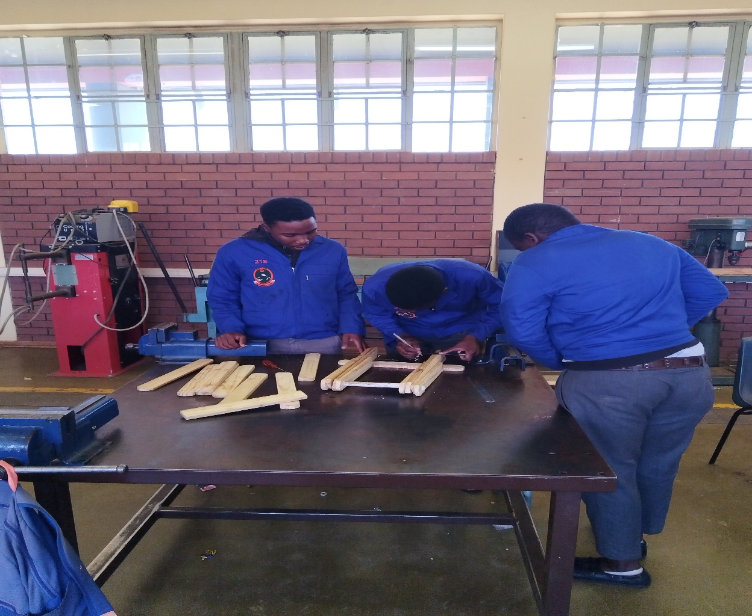
Woodwork Maintenance
Video : Introduction to Woodwork
https://youtu.be/zCNgrOR8FEU/?si=y0DHbd4NS43_Wibm

Slide 2
Lesson objective
At the end of the term learners should be able to know:
1. Woodwork basic safety rules and tools.
2. Building and Plastering basic safety rules and tools.
3. Metalwork basic safety rules and tools.
4. Electricity basic safety rules and tools.
5. Motor Mechanics basic safety rules and tools.
6. Plumbing basic safety rules and tools..
7. Painting basic safety rules and tools.
8. Waterproofing basic safety rules and tools.
9. Glazing basic safety rules and tools.
10. Flooring basic safety rules and tools.
Lesson objectiveV

Slide 3
Prior Knowledge
Names of Ordinary Hand Tools
Uses of Hand Tools

Slide 4
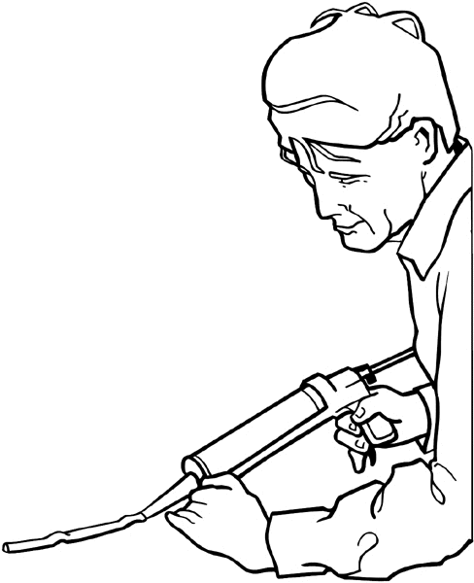
Woodwork Maintenance
Safety rules
You are responsible for your own safety and the safety of others.
N0 alcohol or drugs to be used in the workshop.
Wear appropriately and safe clothing and footwear.
Always use equipments /tools /machinery safely and properly.
Wear personal protective equipments necessary for the job.
Keep your work area clean.
Clean up the spills immediately.
Lift properly using your legs not your back.
Report any unsafe condition.
Report all injuries.
Video:
- https://youtube.com/shorts/RfCo_iF0KzQ?si=MbwKV4VvZCU8BQAs
Feedback: Activity

Slide 5
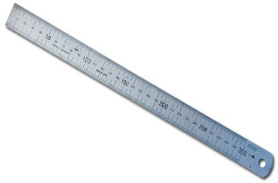

Basic marking cutting hand tools.
1. Ruler
- It is used to measure short distances.
2. Measuring Tape
- It is used to measure shorter or longer distances.

Slide 6


Basic marking cutting and hand tools.
3. Try Square
- It is used for checking square. (internal & external right angles)
4. Bevel
- It is used for making pop marks.

Slide 7
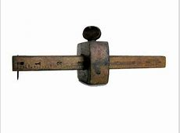
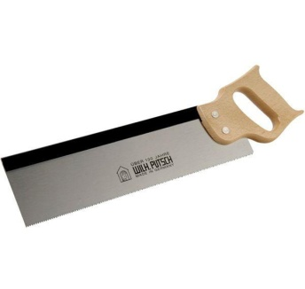
Basic marking cutting hand tools.
5. Marking Gauge
- It is used for drawing lines.
6. Tenon Saw
- It is used for cutting wood.

Slide 8
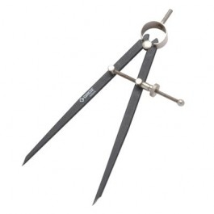

Basic marking cutting hand tools.
7. Divider
- It is used to measure short distances.
8. File
- It is used to measure short or longer distances.

Slide 9
Kwa Skills School
Subject : Maintenance Marks : 10
Grade : Year 1 Time : 30 mins
Date : / / 2024
Question :1
1. Complete the following sentences using the words provided in the bracket below:
1. No alcohol or ___________to be used or allowed in the Workshop.
2. You are responsible for your own safety and _____________ of others.
3. Clean up the _______________ immediately.
4. ______________ all injuries.
5. Keep your work area ___________.
6. Wear appropriate and safe _____________ and footwear.
7. __________ properly using your legs not your back.
8. Always use equipments/ tools/ _________________ safely and properly.
9. Wear personal _________________ equipments necessary for the job.
10. Report any unsafe ____________________.
(10)
(Report; Lift; Drugs; Condition; Clean; Safety; Spills; Protective; Clothing, Equipments)

